Slide 1
CONTACT BOOK
team members:
grandhi v v s sri karunya - 25A31a0575 (team lead)
polisetti sai vishali - 25a31a0594
Thathapudi devakoti - 25a31a05bb
v durga Prasanna - 25a31a05bc

Slide 2
INTRODUCTION
A Contact Book is used to store and manage personal or professional contact details such as names and phone numbers.
Traditional methods may become inefficient when handling large amounts of data.
Using a Linked List improves flexibility in storing contacts dynamically.
It allows easy insertion, deletion, and searching of contacts without fixed memory size.
This project implements a contact book system using linked list data structure for efficient data handling.

Slide 3
CONCEPTS USED
Linked List Data Structure: Used to store contacts dynamically as nodes.
Node Structure: Each node contains contact details (name, phone number) and a pointer to the next node.
Dynamic Memory Allocation: Memory is allocated during runtime for efficient usage.
Pointers: Used to link nodes and navigate through the list.
Traversal: Used to display and search contacts in the list.
Insertion Operation: Adding new contacts to the list.
Deletion Operation: Removing existing contacts from the list.
Searching Algorithm: Finding a contact by name or number.

Slide 4
IMPORTANCE
Provides an efficient way to store and manage contact details.
Allows dynamic memory usage, avoiding wastage of space.
Makes insertion and deletion of contacts easy and fast.
Enables quick searching of contacts when needed.
Overcomes limitations of static data structures like arrays.
Useful for real-world applications like phone directories and contact management systems.

Slide 5
SYSTEM ARCHITECTURE
The project starts by creating an empty linked list to store contacts.
Each contact is stored as a node containing name, phone number, and a pointer to the next node.
Users can add new contacts, which are inserted into the linked list dynamically.
The search operation traverses the list to find a contact by name or number.
The delete operation removes a contact node and updates the links.
The display function shows all stored contacts by traversing the list.
The program continues to run until the user chooses to exit.

Slide 6
CODE
Node* newNode = new Node();
newNode->next = NULL;
// Insert
if (!head) head = newNode;
else {
Node* temp = head;
while (temp->next) temp =
temp->next;
temp->next = newNode;
}
// Traverse
Node* temp = head;
while (temp) temp = temp->next;

Slide 7
// Search
temp = head;
// resetwhile (temp)
{
if (temp->name == key) break;
temp = temp->next;
}

Slide 8
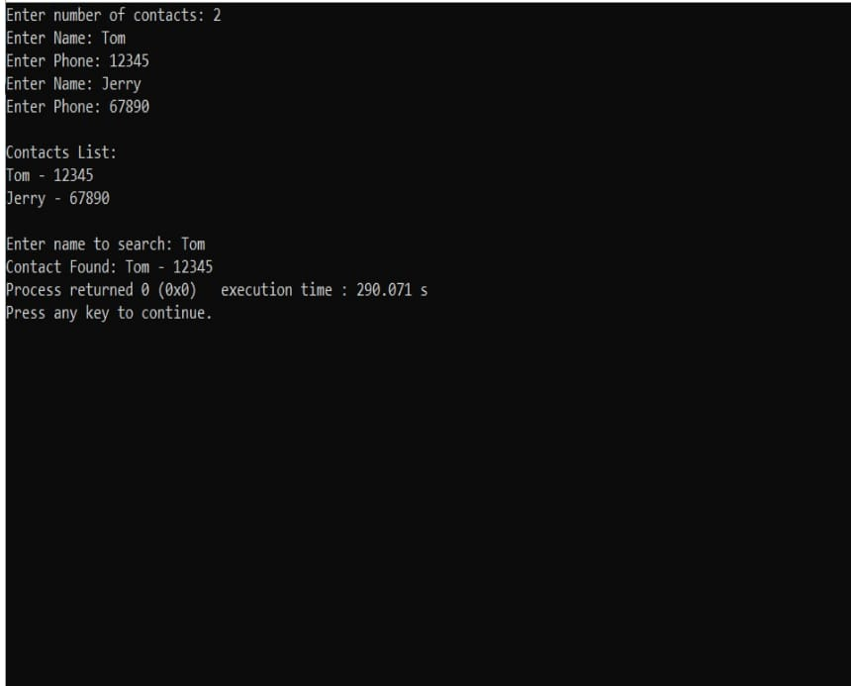
OUTPUT

Slide 9
ADVANTAGES
Dynamic size – no need to define memory size in advance.
Efficient insertion and deletion without shifting elements.
Better memory utilization compared to arrays.
Easy to manage and update contact details.
Flexible structure suitable for growing data.
Simplifies implementation of search and display operations.

Slide 10
CONCLUSION
The contact book using linked list is an efficient way to manage contacts.
It allows dynamic storage and easy modification of data.
Searching, insertion, and deletion operations are simple and effective.
This project helps understand the practical use of linked list data structure.
It can be further improved by adding sorting and file storage features.

Slide 11
THANK YOU

